Slide 1



The construction of the water tank for forest fire management
Doi Tung Development Project
December 2, 2015

Slide 2
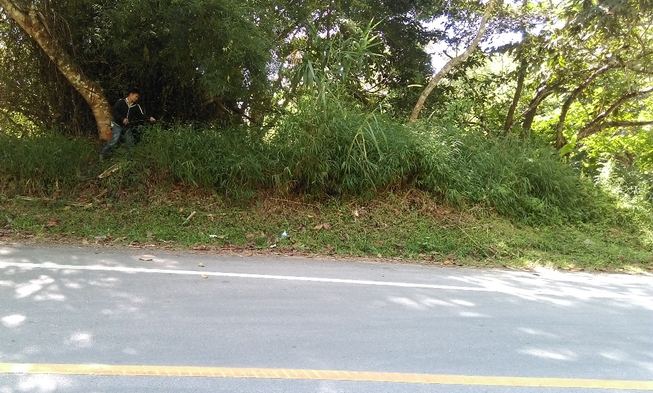
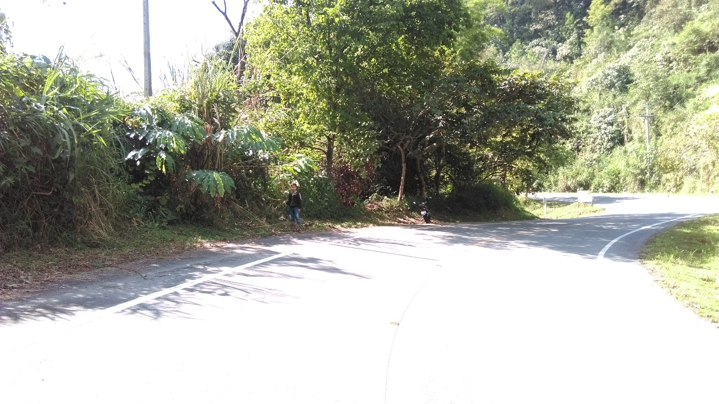
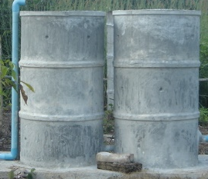
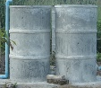
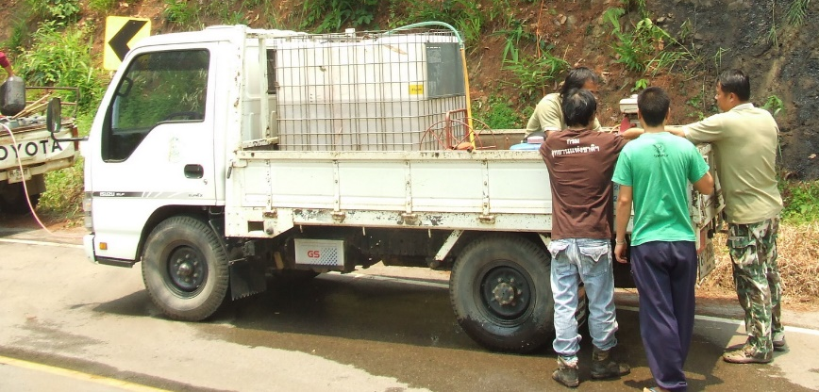
Objective of the construction of the water tank
To supply water for forest fire extinguishment in dry season

Slide 3
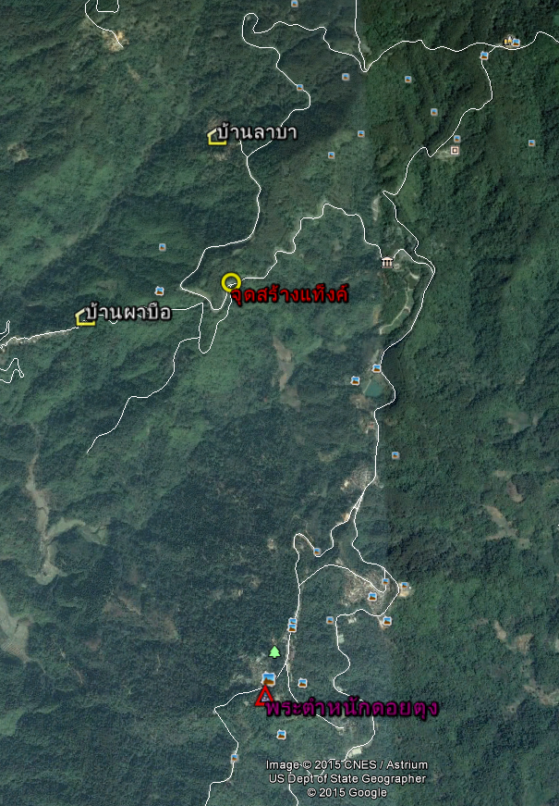
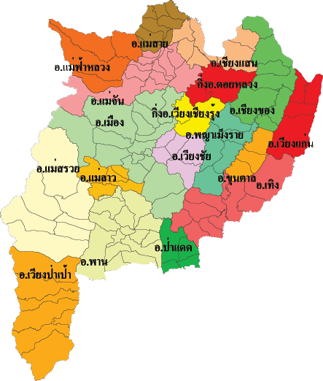
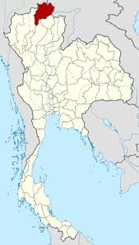
Route Map of Water Tank Building Area
Mae Fah Luang District
N
Chiang Rai Province
Myanmar
Thai
Construction point
Quantity: 2 tanks
Location: Phabue village, Mae Fah Luang subdistrict Mae Fah Luang district Chiang Rai
SAO
The Royal Villa

Slide 4
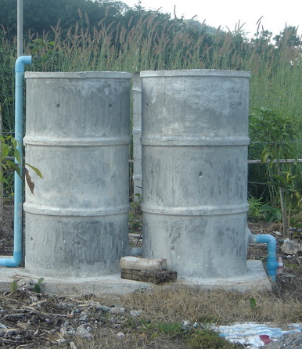
2 water tanks
8 cu.m.

Slide 5
Activities
Activities |  | Number of workers | Duration (min.)
1 | Round cement tank transporting | 12 | 40
2 | Sand transporting | 4 | 90
3 | Cement mixing
4 | Dry pitching | 10 | 90

