Slide 1
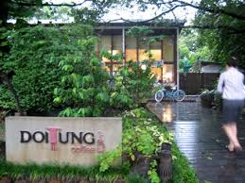



Final presentation
～Study visit
at Mae Fah Luang
Foundation～
From 3rd August to 20th ,2015
Hitotsubashi ICS Class of 2014
Yusuke Takahashi

Slide 2
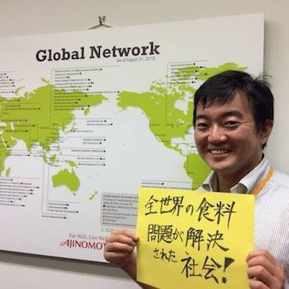
Introduce myself
Yusuke Takahashi （高橋 裕典） 39ys
2000:Biotechnology: MA
American football: BA
2000:AJINOMOTO CORPORATION, LTD.
2000-2011:R&D department (fermentation process)
2011-2014:New business development (Agriculture)
2015: Hitotsubashi ICS MBA (hopefully)
2018:Ghana Ajinomoto (hopefully)
2020:???
1 wife and 1 monster
Like volunteer activity (Town revitalization)

Slide 3

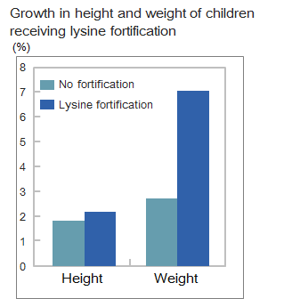
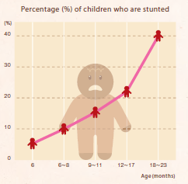

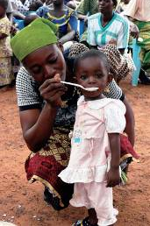
For Example )Ajinomoto Ghana project
My dream
Contribute to solve food problems in the world through business
Persons(%)
of children who are stunted
(%)
40
30
20
10
0
6
6-8
9-11
12-17
18-23
months
There are high expectations for what KOKO+ can reduce malnutrition
Notes:
Ghana Project
To develop and distribute nutritional supplements to improve nourishment of infants during weaning (6-24 months after birth), the period when malnutrition is a particular concern.

Slide 4
Objectives for study visit
～Why I came to MFLF?～
Module 3:Contribution
Module 2:Suggestion
Module 1:Undestanding
To understand current situation
To understand how to solve problems by foundation’s leadership
To understand how to transfer knowledge
To offer suggestions from study visit
To contribute to foundation
～Work hard!～

Slide 5





Today’s Agenda
What I learned
suggestion
Contribution
Conclusion

Slide 6
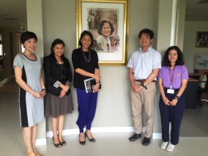
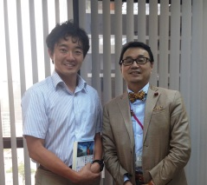
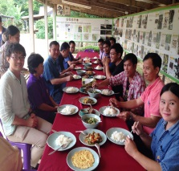
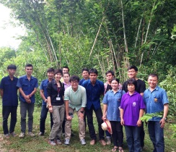
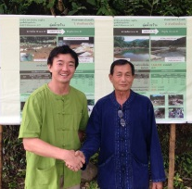
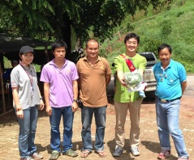
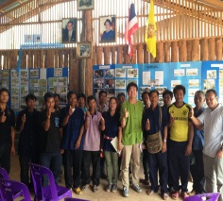
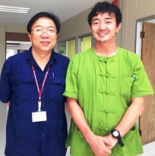
To understand current situation
What I learned
4 in-depth lectures and interviews in Bangkok, Nan province, Doi Tung, Pang Mahan
Day | Day1 August 3rd |  | Day2 4th |  | Day3 5th |  |  | Day4 6th
Location | Bangkok |  | Nan |  |  |  |  | Doi Tung
 | MFLF office | AEON TOPVALU Thailand | Reforestation project office | Visit Villagers And Ban Por weir | Nam Bang Weir | Reforestation project office in Pieng Kor village | The village in Maung district | Doi Tung Area
Activities | Briefing on the work of MFLF | Interview with CEO about production policy of TOPVALU | Briefing on the work in Nan province | To know integrated farming | To understand how to be engaged to construction of the weir | To know people centric approach | To know application of Doi Tung model in Nan province | To know Doi Tung activity
I would like to extend my appreciation to all staffs and stakeholders for my study visit

Slide 7
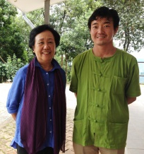
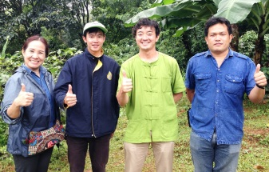
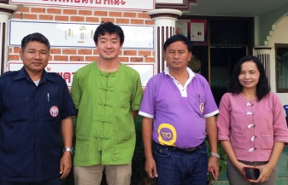
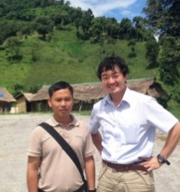
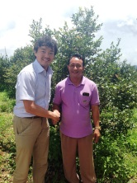
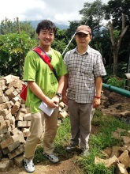
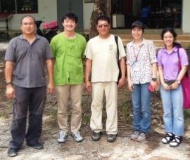
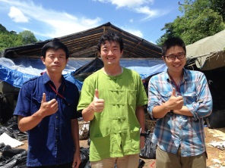
To understand current situation
What I learned
4 in-depth interviews in Bangkok, Nan province, Doi Tung, Pang Mahan
Date | Day5 7th |  |  |  | Day6 8th |  | Day8 10th
Location | Doi Tung |  |  |  | Pang Mahan |  | Doi Tung
 | Project database center | Navuti Company's coffee and macadamia plantation site1 | Cottage Industry center | SAO | Pig Bank | Reforestation office | Navuti site1 | Compost process area | Charcoal area
Activities | How to survey and keep track socioeconomic and environmental data | To know value chain from raw material to factory | To use and improve local wisdom | To know the role of local government | To know how to enhance pig breeding To villagers | To know upstream phase of development | To know how to compost macadamia husks | Discuss with Dr. Jack for my contribution part | Discuss with Dr. Jack for my contribution part
I would like to extend my appreciation to all staffs and stakeholders for my study visit

Slide 8

To understand how to solve problems by foundation’s leadership
Model of the Nation and National Wise Leaders
What I learned
National Wealth
(Performance)
Leadership Process
(6) Foster phronesis
(1) Challenge a good objective
Idealistic
Pragmatism
Historical
Imagination
(5) Maneuver the objective
(2) Observe reality
(4) Articulate a narrative
(3) Create ba
Basic Capacity
Economic Power
Political Power
Social Power
Resource Power
Referred from Hideki Kawada ‘s presentation

Slide 9
Mae Far Luang Foundation(MFLF)’s
Leadership
What I learned
To understand how to solve problems by foundation’s leadership
1) Build “Happy cycle” = Win&Win situation
Example | Reforestation | Economic forestation | Build weir | Establish Pig Bank
Farmer side | Increase income | Increase income | Stable water supply →Improve yield →Increase income | Reduce starting risk Increase income
Government side | Avoid poverty & flood & forest decline | Avoid poverty &flood & forest decline | Avoid poverty &flood &population expansion in urban area | Avoid poverty &population expansion in urban area

Slide 10
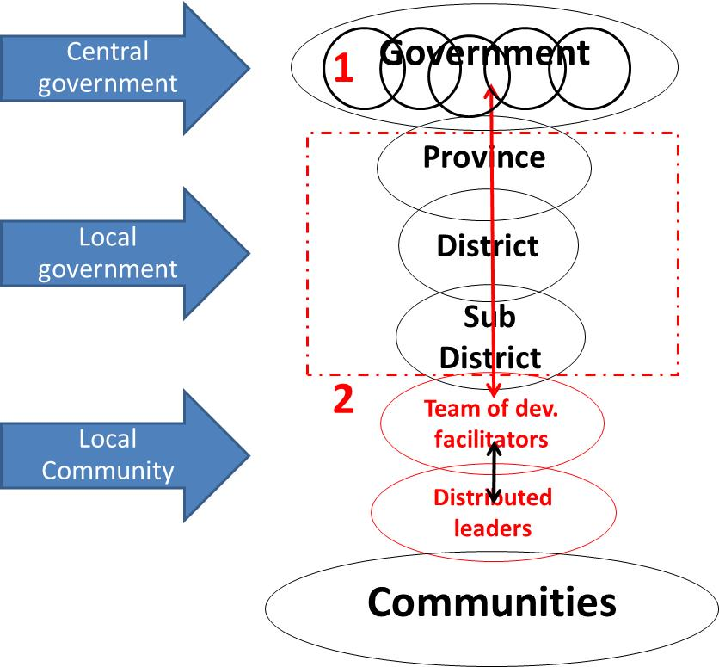
Mae Far Luang Foundation(MFLF)’s
Leadership
What I learned
To understand how to solve problems by foundation’s leadership
2) Connect all stakeholders & Motivate farmers to do voluntary
Trust building
Start with all stakeholders
Pursue local leader
Reduce starting risk
Incentive to farmers
Social psychology
Referred from Hideki Kawada ‘s presentation

Slide 11
Mae Far Luang Foundation(MFLF)’s
Leadership
What I learned
To understand how to solve problems by foundation’s leadership
3) Motivate farmers to maintain activities
Realize improvement of livelihood
Incubate ownership
Inspection and pay
Continue to take care farmers for evolution from survival stage to sufficient stage and to sustainable stage
Use Social psychology
Final objective is ”Help people to help themselves”

Slide 12
MFLF’S Knowledge transfer
What I learned
To understand how to transfer knowledge
NGO, local leader are very effective
collaborator for knowledge transfer
Reforestation project in Pieng Kor village
The village
in Maung district
project]
1year
(normally 3year)
DoiTung project
20-30years
Nan reforesting
Project
Pang Mahan
project
7years
Ban Por weir
Project
NGO
Love Nan
Myanmar
Afghanistan
Indonesia
MFLF
NGO
Nam Bang Weir
Project
local leader
Other village
Other village

Slide 13
Today’s Agenda
What I learned
suggestion
Contribution
Conclusion

Slide 14
４ suggestions
What I learned
Suggestion
①Pursue CSV for villagers
>>Collaborate with Retailer by Co-branding
②Send market price information to farmers
③New study trekking course
④Developing new value-added compost

Slide 15
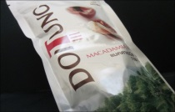
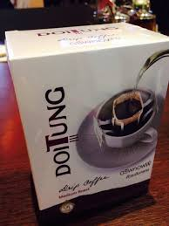
Pursue CSV for villagers
What I learned
Suggestion
Suggestion1
Where is the position
of DoiTung cofee&nuts?
What is CSV?
Strong
Creating shared value (CSV) is a business concept introduced by Michael E. Porter.
CSR
CSV
Societal Impact
Pursuing BOTH societal impact and economic impact progress has the power of improvement for villager’s livelihood.
PPP
(Pure Pursuit of Profit)
Compliance
Weak
Weak
Strong
Economic Impact
MFLF’s business should maintain CSV position for
sustainable livelihood growth of villagers

Slide 16
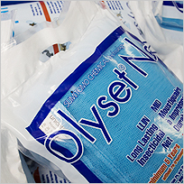
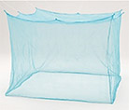
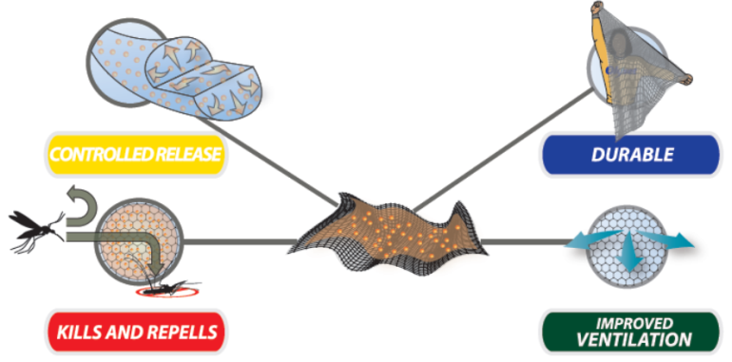
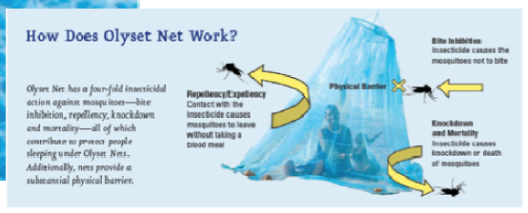
What is Olyset Net?
→Long Lasting Insecticide-treated mosquito Net
(LLIN)
What I learned
Suggestion
Pursue CSV for villagers
Successful example of CSV
Olyset Net business of Sumitomo Chemical
Olyset™
→5year lasting
http://www.sumitomo-chem.co.jp/english/csr/olysetnet/malaria.html

Slide 17
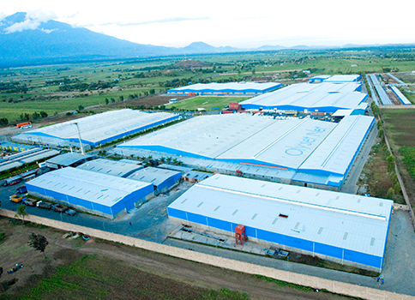
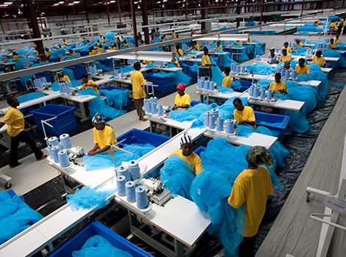
Successful example of CSV
Current Situation
Pursue CSV for villagers
▼yearly change of mortality rate
by malaria
Olyset business has sufficient social impact.
1) Contributing to Decrease mortality rate
50
For example, from 2012 to 2014, 427million LLINs were
distributed by global fund, such as UNICEF. and mortality
rate by Marilia drastically decreased.
Decreased mortality rate by Marilia since 2000:
Asia 47% decrease, Africa 54%.
Malaria deaths per1000persons at risk
25
2) Licensing technologies to local factory (A to Z CO, Ltd in Tanzania)
For free
2000
2013
Source: World malaria report
3) Hiring many local employee with great social welfare
Local factory contributed to create employment opportunities for up to approximately 7,000 local people.
Employees are provided free lunch service, free transportation, medical insurance welfare, pension fund by the factory.
Interviewee of employee were satisfied with their treatments.
Source: I interview with Mr. Yamaguchi, Mr. Mizuno, AtoZ employees

Slide 18

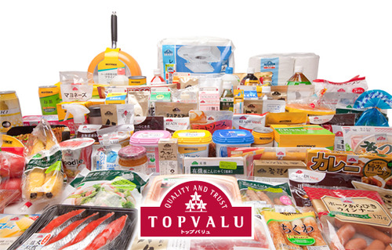
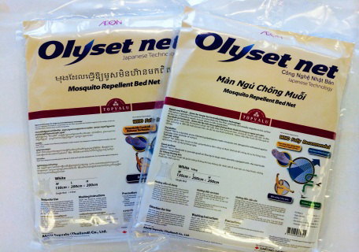
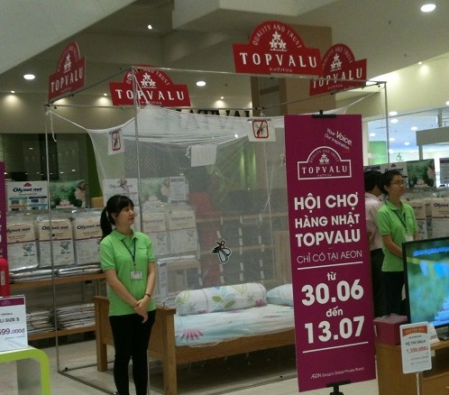
Successful example of CSV
What I learned
Suggestion
Pursue CSV for villagers
Olyset business has sufficient economic impact
by co-branding with AEON (Vietnam, Cambodia, Thailand)
4C
Company: Sumitomo Chemical jointed with AEON
Customer: Middle income layer is increasing.(GDP per capita is $1105)
Channel: Modern trade is becomes popular (20%). Sumitomo
Chemical tried to find channel of modern trade.
Collaborator: AEON (No.1 retailer in Japan)
TOPVALU is AEON’s private bland （6000 items）
TOPVALU shows security/safety and reasonable price.
4P
Product: TOP VALU Olyset™ (2014)
Place: Super market (AEON)
Price:30US$ (XX times compare to B to B business)
Promotion: Promotion by salesperson
and visual merchandizing by AEON
Cooperation with Supermarket (Co- branding ) works well for CSV.
Source: Interview with Mr. Yamaguchi, Mr. Arimoto, Mr. Horii

Slide 19




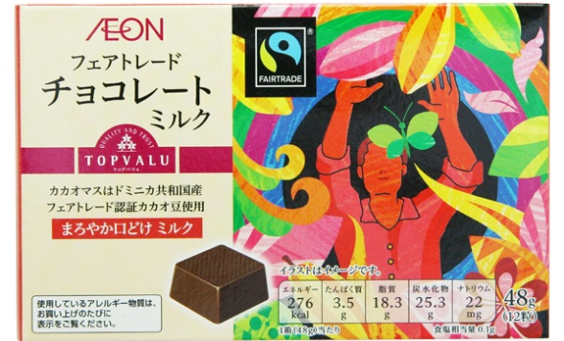
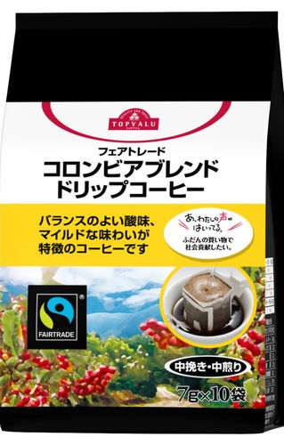

Co-branding with AEON
TOPVALU-DoiTung macadamia nuts
TOPVALU-DoiTung Coffee
Suggestion1
What I learned
Suggestion
Pursue CSV for villagers
×
4P
Product: TOP VALU DoiTung Macadamia nuts or Coffee
Place: Japanese Super market (AEON)
Price: XXX
Promotion: Promotion by salesperson and visual merchandizing by AEON
Merit (DoiTung brand) :
1)Premium price
2)To get Japanese
STRICT Quality Control system &
STRICT Traceability system
Merit (TOPVALU) :
1) Raise brand value
2) Increase store royalty by original products
▲TOPVALU Fair trade
chocolate & coffee

Slide 20
Pursue CSV for villagers
What I learned
Suggestion
Co-branding with AEON
TOPVALU-DoiTung macadamia nuts
TOPVALU-DoiTung Coffee
×
Interview with Mr. Horii at Bangkok
He visited DoiTung three years ago.
His concerns in case of Co-branding were
1 ) Volume
2) Stable supply :
3) Traceability
Raw material management
Packing material management
Mr. Horii
Ex -product general manager of TOPVALU
Now- CEO of AEON TOPVALU Thailand
(ITF TowerⅡ,21st Floor,Silom Road)
DoiTung will become represent of Thai brands
And also DoiTung activity gets many awards.
→More strict traceability would be essential in future

Slide 21
Suggestion2
What I learned
Suggestion
Send market price information to farmers
in order to negotiate with broker
Africa’s case
the explosive spread in the use of mobile phone
↓
Farmers could gather market information
↓
They has become possible to negotiate with broker
↓
Increase farmer’s income
Generate “Considerable Farmers”
Educate to farmers
how to gather
information

Slide 22
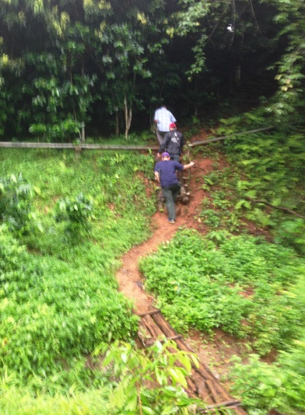
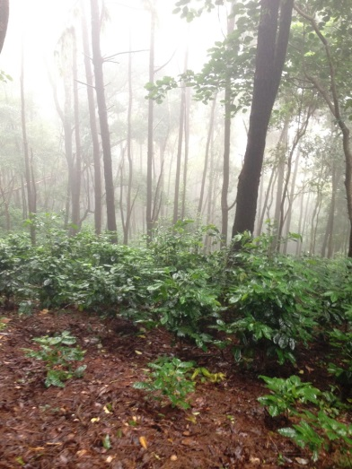
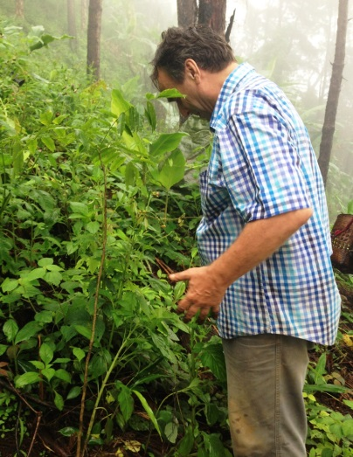
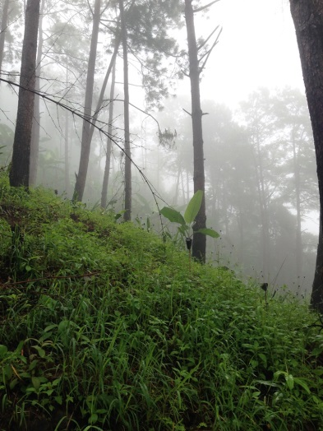
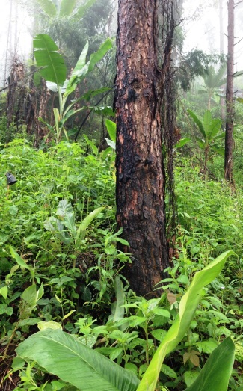
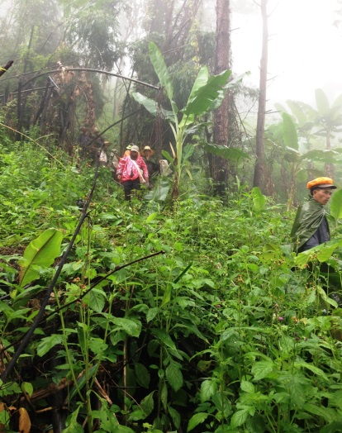
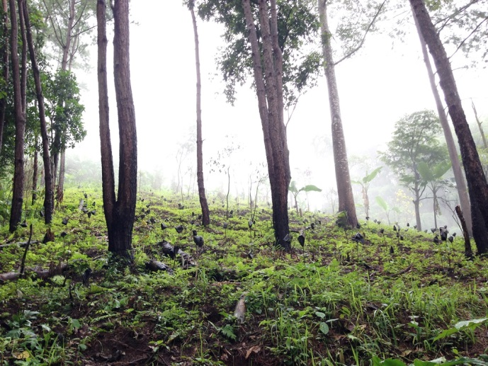
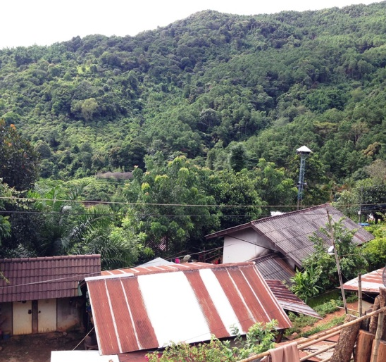

Suggestion3
What I learned
Suggestion
New study trekking course : Near to DoiTung area
Economic forest> lecture of Botany> Pine tree
>forest fire>reforestation area>Laba village=3hr

Slide 23
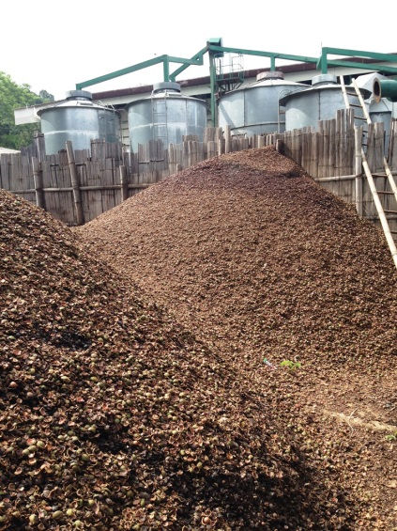
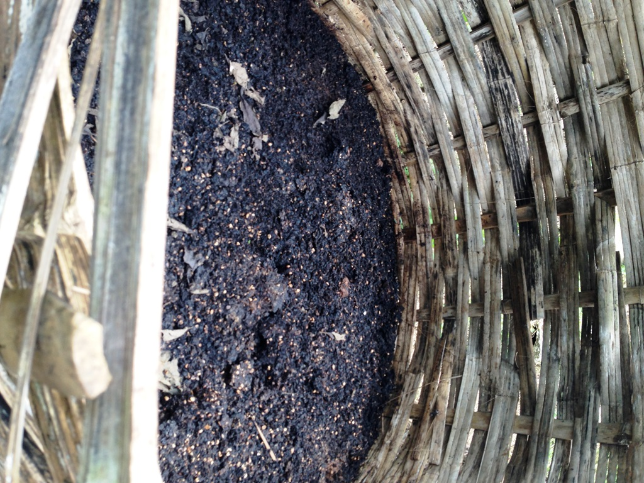
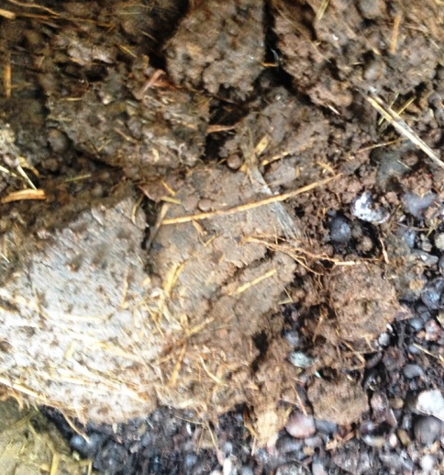
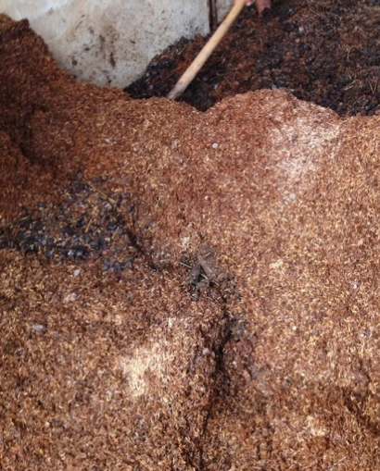
Suggestion4
What I learned
Suggestion
Developing new value-added compost
Variety of effective byproducts is composted.
Macadamia husks
Coffee Pulps
Goat manure
Chicken manure
Increase microbial activity
Increase pH
Increase microbial activity
High Potassium
Nitrogen source
Nitrogen source
Phosphate source
Decrease density (rice husks)
There is a possibility to produce value-added compost by mixing these byproducts

Slide 24
Today’s Agenda
What I learned
suggestion
Contribution
Conclusion

Slide 25
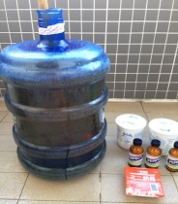
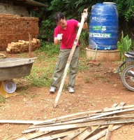
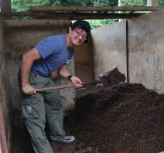





Contribution part schedule
What I learned
Suggestion
Contribution
4 works has been done day11th to18th.
Date | Day9 11th | Day10 12th | Day11 13th | Day12 14th | Day13,14 15th,16th |  | Day15 17th | Day16 18th
Location | Doi Tung
 | My room | Office | Charcoal area | Compost area | Forest near to Laba | Laba village | Compost area | Coffee Site1 | Charcoal area
Activities | Make NYLA liquid | Think Experimental condition | Cut Bamboo | make value added compost/make charcoal | Walk economic forest and reforestation area | To realize improvement of village’s life | Teach how to make NYLA liquid | To know how to improve productivity & quality | Start make bamboo charcoal
I would like to extend my appreciation to all staffs and stakeholders for my study visit

Slide 26
3 contributions
～Work hard!～
What I learned
Suggestion
Contribution
①Making NYLA liquid
②Develop new value added compost
③Improve production process for bamboo
charcoal (based on Dr. Jack’s idea)

Slide 27







Contribution 1: Making NYLA liquid
What I learned
Suggestion
Contribution
What is NYLA liquid?
The liquid contains 4type of bacteria.
Japanese farmers traditionally make and use it for compost, liquid fertilizer, etc.
There are Scientific evidences.
N (Natto:Bacillus subtilis var. natto)
40piece/L; Sold in Chiang Rai, Bangkok
Y (Yeast: Saccharomyces cerevisiae)
4g/L
L (Yogurt:Lactobacillus)
50g/L
A (Miso:Aspergillus oryzae)
5g/L
Sold in
Maesai
Sugar
50g/L
+
DoiTung
Pure water
20L

Slide 28











Contribution 1: Making NYLA liquid
What I learned
Suggestion
Contribution
How to make?
Very easy to make
Yeast>Yogurt>Natto (only washed solution)>Miso>Sugar
Finish from 3days to 7days (pH3-4, good smell)
Useable for 3month
DoiTung
Pure water
20L
Start
DO NOT
Close
cap
Mix
Finish (3days)

Slide 29




Contribution 1: Making NYLA liquid
What I learned
Suggestion
Contribution
What kind of effect does NYLA liquid have?
Reduce smell
Reduce sludge in septic tank
Increase effective bacteria in compost
Increase speed of composting
Increase immunity of plants
Many effective bacteria
Neutralization
Accelerate fermentation
Add weekly
*100 dilution
Volume of sludge
COD
Adding 5%
NYLA
Smell
http://www.pref.ehime.jp/h30103/sangiken/alls/etc/documents/ai-1.pdf
Mr. Aon and I made 50L. Please try to use!

Slide 30

What I learned
Suggestion
Contribution
Contribution 2:
Develop new value added compost
Value: Increase microbial activity, water holding capacity,
Increase pH, carbon and nitrogen source
Macadamia husks
Coffee Pulps
Goat manure
Chicken manure
40%
10%
35%
(Ideal 25%)
15%
(Ideal 25%)
Increase microbial activity
Increase pH
Increase microbial activity
High Potassium
Nitrogen source
Adjust C/N
Nitrogen source
Adjust C/N
Phosphate source
Decrease density (rice husks)
+5%NYLA

Slide 31






What I learned
Suggestion
Contribution
Contribution 2:
Develop new value added compost
Start at 14th Aug →Finish:1～3month→Test by Dr.Martin at Nursery
7:NYLA
addition
10:NYLA
omission

Slide 32
What I learned
Suggestion
Contribution
Contribution 3:
Improve production process for bamboo
charcoal (based on Dr. Jack’s idea)
Final Objective : Produce high quality bamboo charcoal which can be
used for high end products (air or water purification)
Experimental condition (Iwate kiln)
 | Objective | Condition
① | Improve productivity | Cut bamboo and make all of uniform length (165cm and 90cm) Remove joint
② | Improve yield | Select good bamboo
③ | Improve charcoal quality by increasing maximum temperature | Add wood (50%) Push bamboo into kiln without free space

Slide 33

Contribution 3:
Improve production process for bamboo charcoal
What I learned
Suggestion
Contribution
Result
We pushed 660kg bamboo and 176kg woods into kiln.
Front temperature at 2nd day is high compare to second trial→effect of wood
Back temperature at 2nd day is low →effect of high density of bamboo
 | Bamboo (kg) | Tree (kg) | Total (kg) | Temperature (℃) at 2nd day |  | Productivity (kg) | Yield (%)
 |  |  |  | front | back
1 | 750 | 0 | 750 | - | - | 33 | 4.4
2 | 571 | 0 | 571 | 208.5 | 79.6 | 106 | 18.6
3 | 660 | 176 | 836 | 265.1 | 44.8 | ? | ?
 | 79% | 21%
Concern
It takes time to cut bamboo and remove joint.
→15person-day for 660kg

Slide 34





Contribution 3:
Improve production process for bamboo charcoal
What I learned
Suggestion
Contribution
Operation
・Cut bamboo and make all of uniform length (165cm and 90cm)
・Remove joint
165cm
90cm
・Select good bamboo
・Push bamboo into kiln
without free space
・Add woods

Slide 35
Today’s Agenda
What I learned
suggestion
Contribution
Conclusion

Slide 36

What I learned
Suggestion
Contribution
Conclusion
Conclusion
To understand how to solve problems by foundation’s leadership
To understand how to transfer knowledge
To offer suggestions from study visit
To contribute to foundation
～Work hard!～
①Build “Happy cycle” =Win&Win situation
②Connect all stakeholders & Motivate farmers to do voluntary
③Motivate farmers to maintain activities
Final objective is ”Help people to help themselves”
NGO, local leader are very effective collaborator for knowledge transfer
①Pursue CSV for villagers >>Collaborate with Retailer by Co-branding
②Send market price information to farmers
③New study trekking course
④Developing new value-added compost
①Making NYLA liquid
②Develop new value added compost
③Improve production process for bamboo charcoal (based on Dr. Jack’s idea)
.
Notes:
According to Euromonitor: grocery retailers are categorized into…
Grocery Retailers
Modern Grocery Retailers
Convenience Stores
Discounters
Forecourt Retailers
Chained Forecourts
Independent Forecourts
Hypermarkets
Supermarkets
Traditional Grocery Retailers
Food/Drink/Tobacco Specialists
Independent Small Grocers
Other Grocery Retailers
http://www.nielsen.com/us/en/insights/news/2011/the-future-of-shopping-in-india.html

Slide 37




What I learned
Suggestion
Contribution
Conclusion
Finally
Valuable for Novel prize!
Notes:
According to Euromonitor: grocery retailers are categorized into…
Grocery Retailers
Modern Grocery Retailers
Convenience Stores
Discounters
Forecourt Retailers
Chained Forecourts
Independent Forecourts
Hypermarkets
Supermarkets
Traditional Grocery Retailers
Food/Drink/Tobacco Specialists
Independent Small Grocers
Other Grocery Retailers
http://www.nielsen.com/us/en/insights/news/2011/the-future-of-shopping-in-india.html

Slide 38


Special thanks for my study visit

Slide 39

Fin
Thank you

Slide 40

Appendix

Slide 41
Appendix)Flow sheet of NYLA liquid
BIG Scale

Slide 42
Appendix)Flow sheet of NYLA Compost
Fertilizer design
Name ： NYLA Compost |  |  |  |  |  |  |  |  | Total
row material |  |  |  | designed value (%) |  |  |  |  | 600 | kg
名称 | name | ingredient amount(%) | rate (%) by weight | C/N | Density | TN | TP | TK | used amount (kg) | Reason for use
Macadamia husks | TN | 1.30 | 38.5 |  |  | 0.50 |  |  |  | Macadamia husk compost improved the soil health of the orchard soil by increasing microbial activity, water holding capacity, pH, carbon and nitrogen.
 | TP |  |  | 38 | 0.6 |  | 0.00 |  | 300
 | TK |  |  |  |  |  |  | 0.00
Coffee Pulps | TN | 1.27 | 13.0 |  |  | 0.16 |  |  |  | Increase fermentation by contained sugar
 | TP | 0.06 |  | 40 | 0.9 |  | 0.00 |  | 101
 | TK | 2.46 |  |  |  |  |  | 0.31
Goat manure | TN | 1.37 | 35.0 |  |  | 0.47 |  |  |  | Improve C/N ratio
 | TP | 0.30 |  | 14 | 0.9 |  | 0.10 |  | 273
 | TK | 0.98 |  |  |  |  |  | 0.34
Chicken manure | TN | 0.50 | 13.5 |  |  | 0.06 |  |  |  | Decrease density control moisture rate
(Almost rise husks) | TP |  |  | 25 | 0.5 |  | 0.00 |  | 105
 | TK |  |  |  |  |  |  | 0.00
 | Total | design | 100.0 | 28 | 0.731 | 1.13 | 0.10 | 0.65 | 780 | kg
NYLA liquid |  |  | 5.0 | - |  | - | - | - | 39 | Increase fermentation Increase effective bacteria
http://www.dpi.nsw.gov.au/__data/assets/pdf_file/0003/166476/compost-on-farm.pdf
http://jairjp.com/SEPTEMBER%202014/09%20SEKHAR.pdf
http://www.ijappjournal.com/wp-content/uploads/2013/07/3360-3365.pdf
http://www.ijappjournal.com/wp-content/uploads/2013/07/3360-3365.pdf

Slide 43
Appendix)Flow sheet of NYLA Compost
Ideal condition
Fertilizer design
Name ： NYLA Compost |  |  |  |  |  |  |  | Total
row material |  |  |  | designed value (%) |  |  |  | 600 | kg
名称 | name | ingredient amount(%) | rate (%) by weight | C/N | TN | TP | TK | used amount (kg) | Reason for use
Macadamia husks | TN | 1.30 | 40.0 |  | 0.52 |  |  |  | Macadamia husk compost improved the soil health of the orchard soil by increasing microbial activity, water holding capacity, pH, carbon and nitrogen.
 | TP |  |  | 38 |  | 0.00 |  | 240
 | TK |  |  |  |  |  | 0.00
Coffee Pulps | TN | 1.27 | 10.0 |  | 0.12 |  |  |  | Increase fermentation by contained sugar
 | TP | 0.06 |  | 40 |  | 0.00 |  | 60
 | TK | 2.46 |  |  |  |  | 0.24
Goat manure | TN | 1.37 | 25.0 |  | 0.34 |  |  |  | Improve C/N ratio
 | TP | 0.30 |  | 14 |  | 0.07 |  | 150
 | TK | 0.98 |  |  |  |  | 0.24
Chicken manure | TN | 2.06 | 25.0 |  | 0.51 |  |  |  | Improve C/N ratio
 | TP | 0.25 |  | 7 |  | 0.06 |  | 150
 | TK | 1.24 |  |  |  |  | 0.31
 | Total | design | 100.0 | 22 | 0.98 | 0.07 | 0.48 | 600 | kg
NYLA liquid |  |  | 5.0 | - | - | - | - | 30 | Increase fermentation decrease smell
http://www.dpi.nsw.gov.au/__data/assets/pdf_file/0003/166476/compost-on-farm.pdf
http://jairjp.com/SEPTEMBER%202014/09%20SEKHAR.pdf
http://www.ijappjournal.com/wp-content/uploads/2013/07/3360-3365.pdf
http://www.ijappjournal.com/wp-content/uploads/2013/07/3360-3365.pdf

